Slide 1





1
Presented by: Group 8
Akhil Talashi
Himanshu Mal
Jayesh Tak
Saipranath Gopathi
Ilia Chiniforooshan Esfahani
Darshan Patel

Slide 2


2
Abstract
Tech-Stack
Features
UML Diagram
MVC Design Pattern
Factory Pattern Method
Contributions
GUI
Future enhancements
Lessons Learned
Table of Contents

Slide 3

Abstract
This application is that of a Day Care System which is in par with a real-world application, that consists of various Organizations and Roles. The project is implemented using Swing GUI widget toolkit.
It is a School Management(Day Care) System with features that provides access to:
Adding Students and Teachers with their details, easily updating, deleting records & viewing all records
Adding Vaccine information for each student
Provides a feature for the teachers to view students who are yet to take the vaccine
Giving feedback of Teachers by Students using the Annual Review feature
Provides alerts for student vaccination and teachers annual review
3

Slide 4



Tech Stack
Java
Swing For GUI
Java AWT
4
MVC Architecture
db4o

Slide 5
Features
A user can login and logout of his Day Care Account
A user can use Admin Panel to manage(CRUD) Students, Teachers, Classrooms and Alerts
Complies DayCare Ratio and Immunization Rules
A user can performed CRUD operations on Student Management Panel:
Remove Students
Update Student Personal Information
Add Student Immunization details
Employee annual reviews can be added on the Teacher Management Panel
Track student immunization record and Annual registration from original walk-in date
5

Slide 6
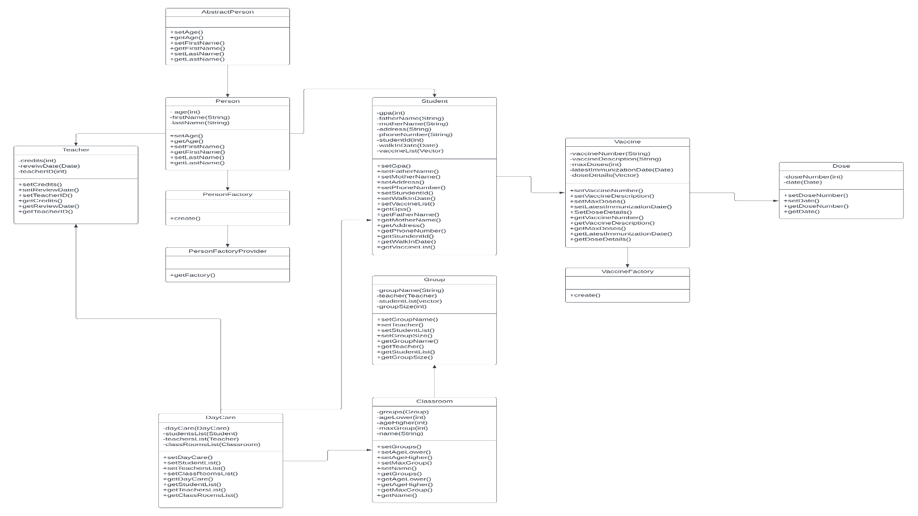
UML Diagram
6

Slide 7
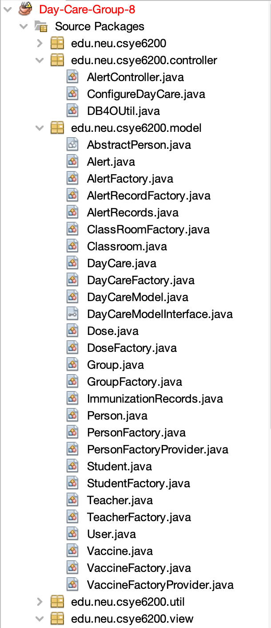
MVC Design Pattern
Model
Mapper and Dao contains the pure application data
View
Present the data to user, the html page
Controller
Listens to events triggered by view, between view and module, use Json and API to communication. In most cases, the reaction is to call a method on the model.
7

Slide 8
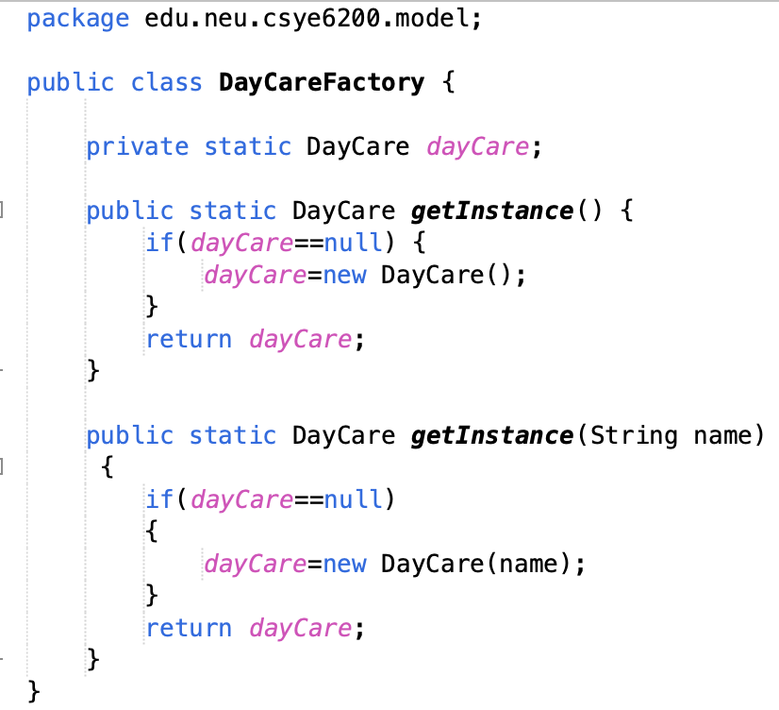
Factory Pattern Method
To maintain loose coupling and high cohesion we used factory pattern method to create objects of the class
Created Factories for Student Class , Teacher Class , Vaccine Class, Dose Class and DayCare Class
8

Slide 9
₉
Contributions
Akhil Talashi
Himanshu Mal
Jayesh Tak
GUI Design
Admin Home Panel
Teachers Review Panel
Presentation
Login page and authorization
Design Patterns
Student View, Update & Alert Panel
Teacher Registration Panel
Teacher View Panel
Manual Testing
Saipranath Gopathi
Darshan Patel
Ilia Chiniforooshan Esfahani
Student Registration Panel
UML Diagram Designing
Manual Testing
Create Classroom Panel
Add Classroom Group Panel
Classroom View Panel
Add Students to Classroom Group Panel

Slide 10
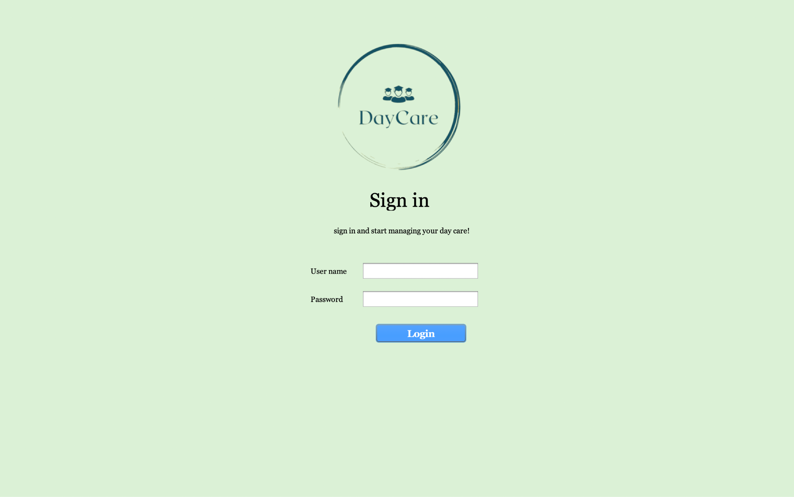
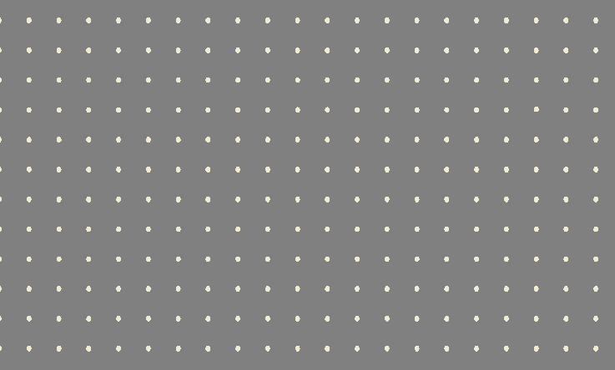
GUI
Login Page
10

Slide 11
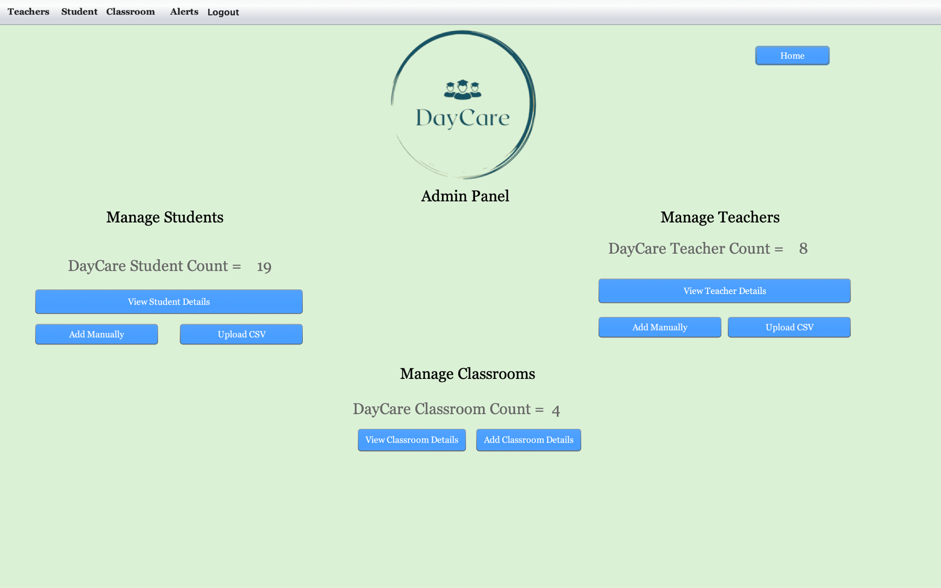
GUI
Home Page
11

Slide 12
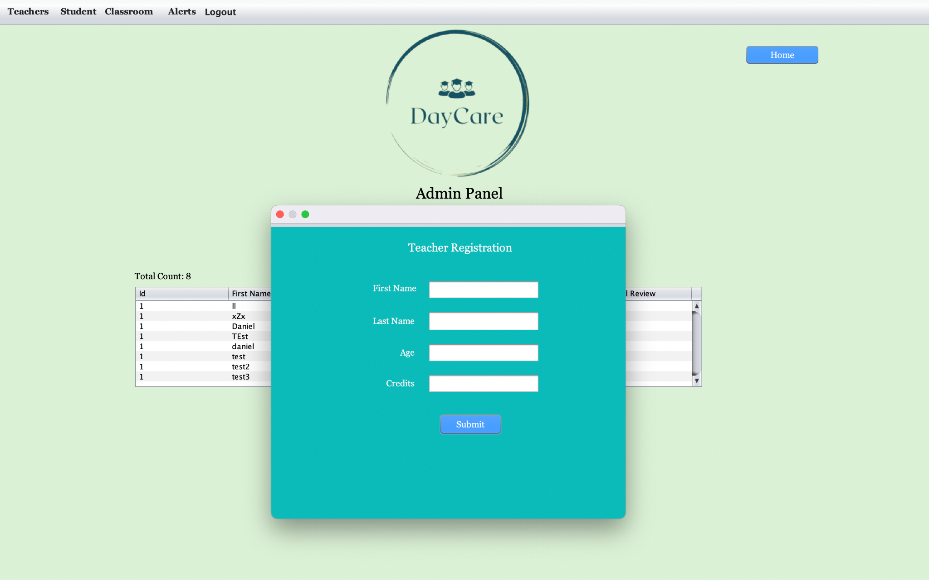
GUI
Teacher Registration
12

Slide 13
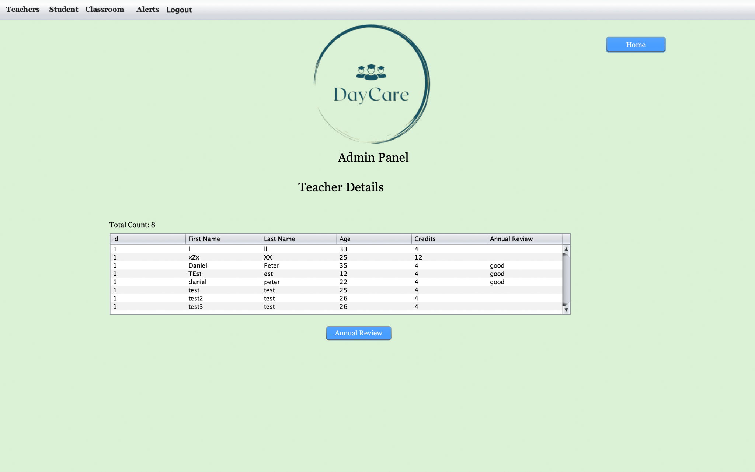
GUI
Teacher View Panel
13

Slide 14
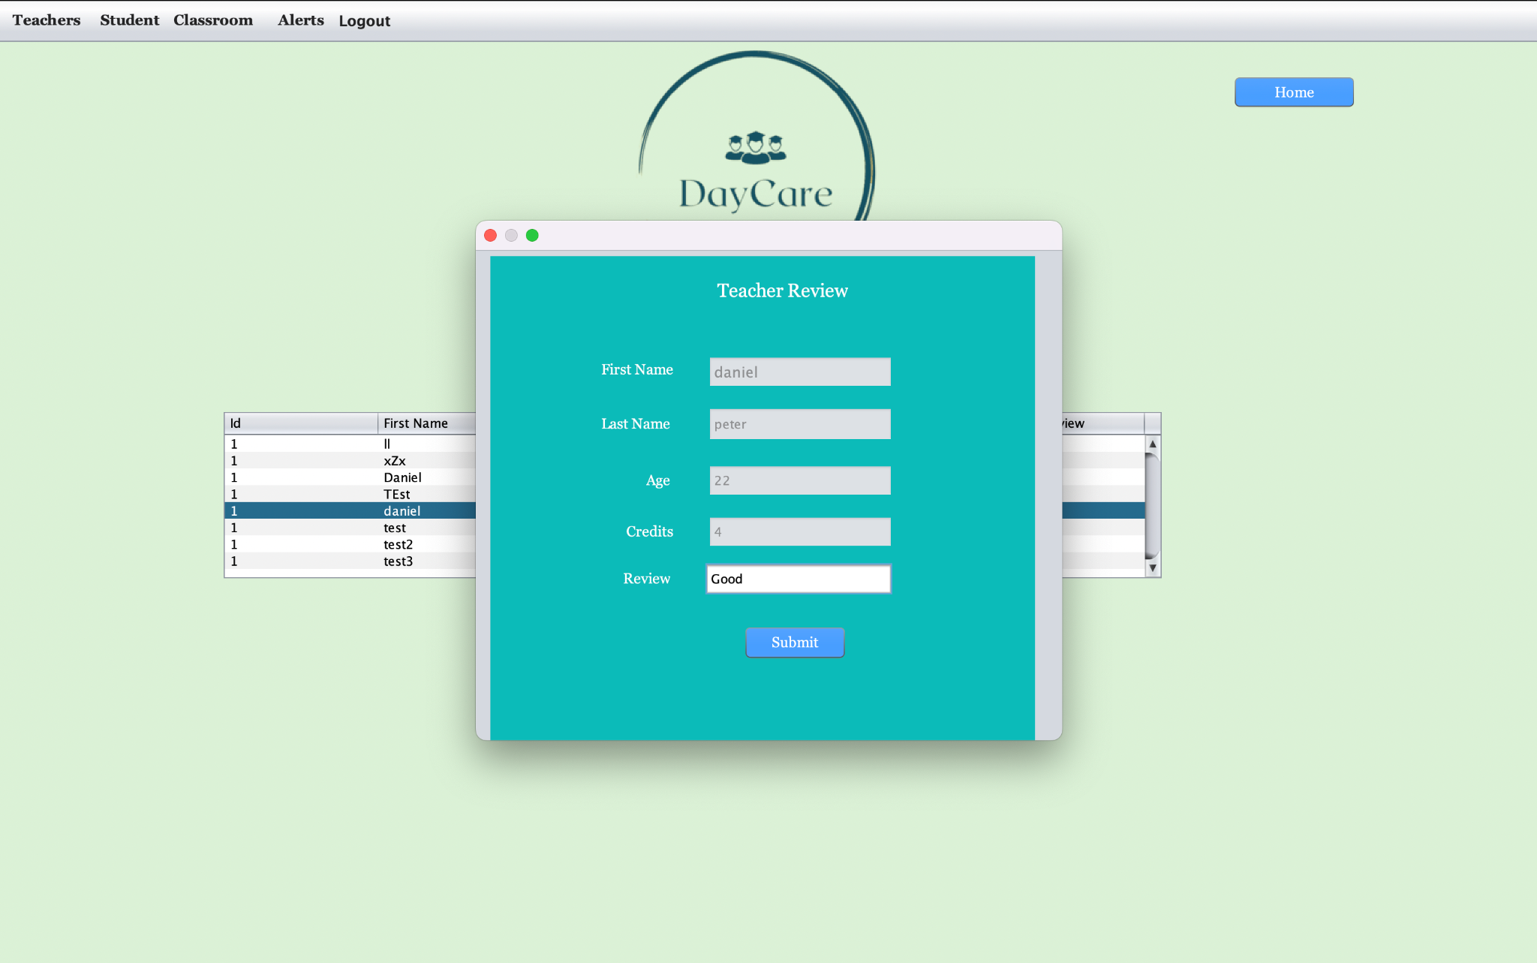
GUI
Teacher Annual Review
14

Slide 15
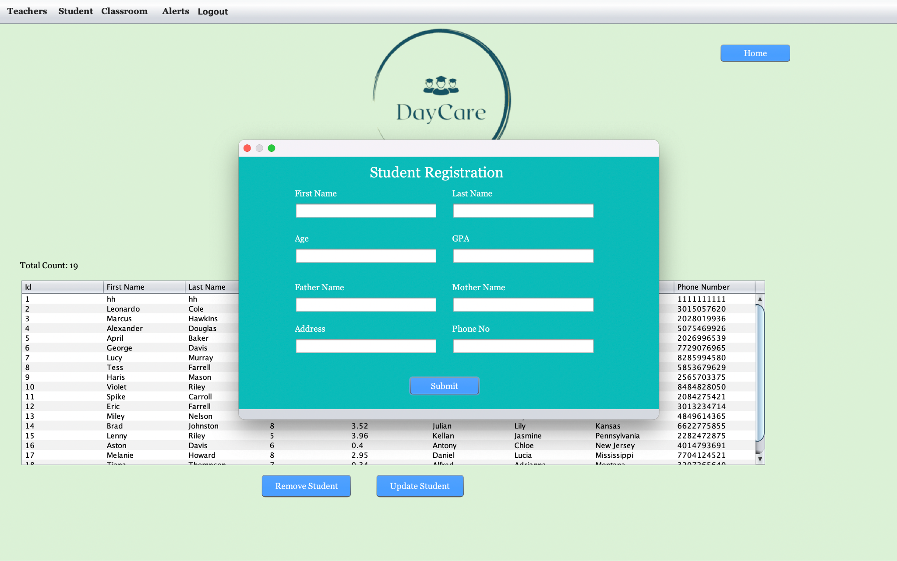
GUI
Student Registration
15

Slide 16
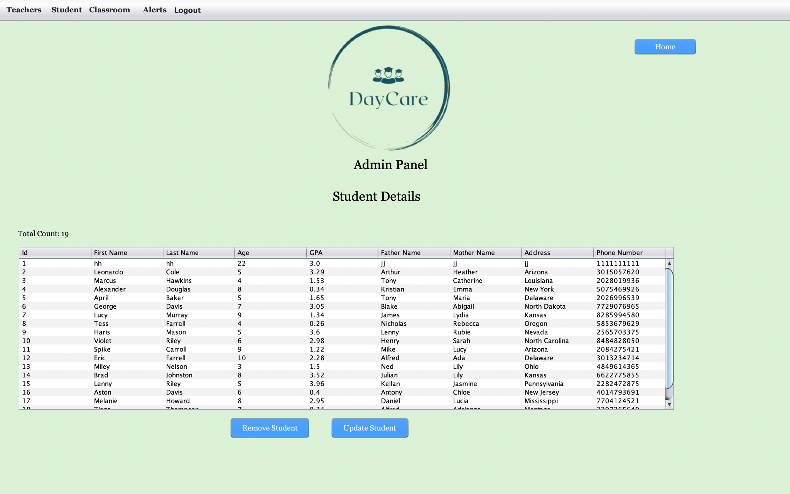
GUI
Student Details
16

Slide 17
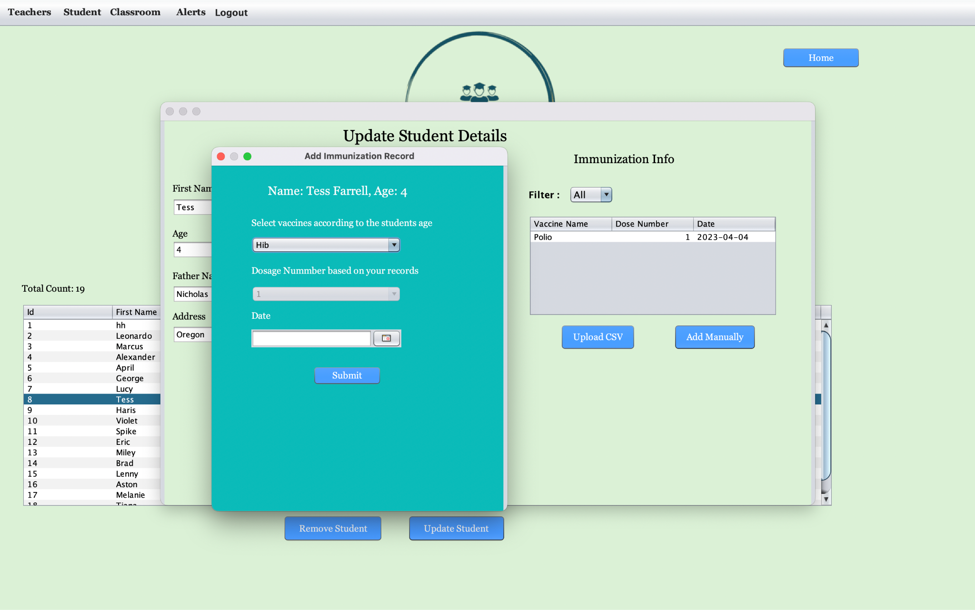
GUI
Immunization Panel
17

Slide 18
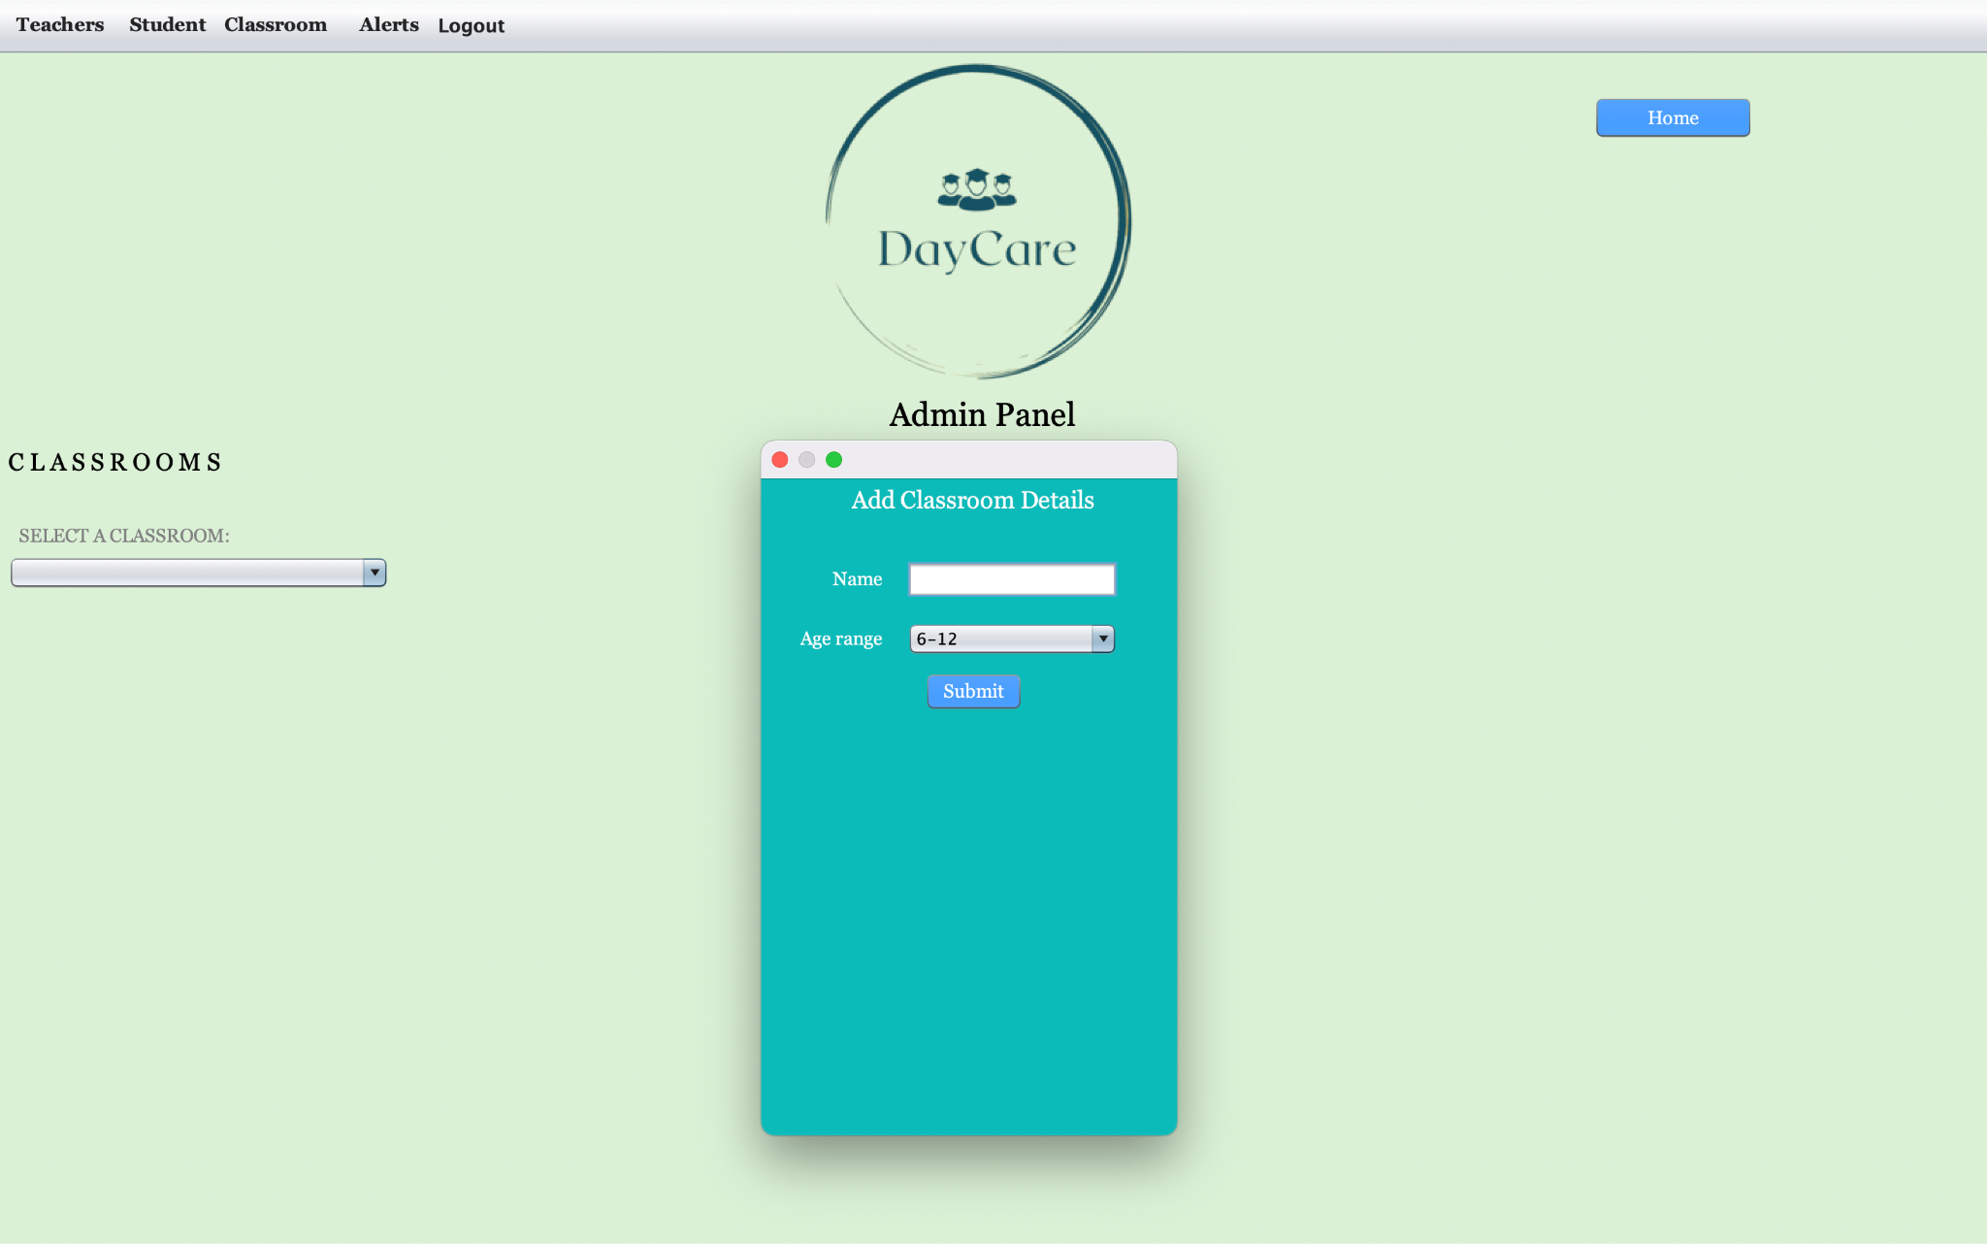
GUI
Classroom Registration
18

Slide 19
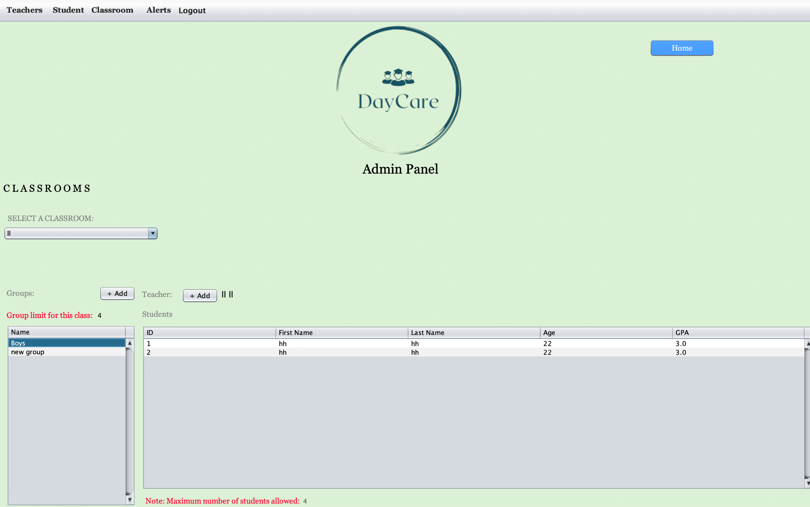
GUI
ClassRoom Details
19

Slide 20
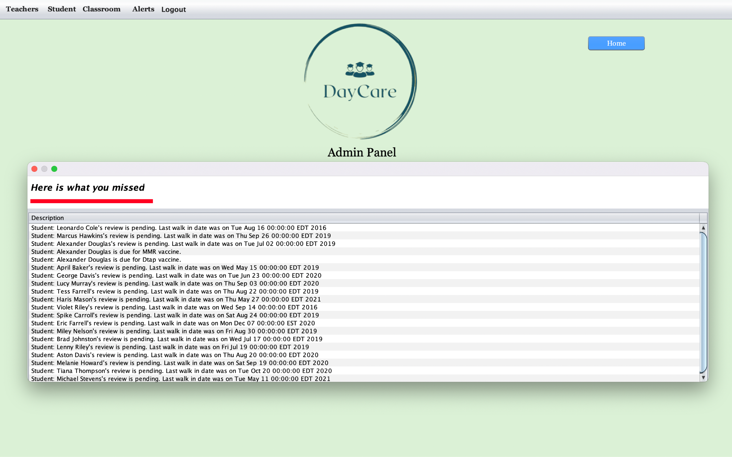
GUI
Alerts
20

Slide 21
Future Enhancements
Creation of course enrollment page for students to register to courses
Create individual sign-up pages for creating accounts
Triggering email notification for every user creation and updates to their accounts
Make use of Spring boot instead of swing for more user friendly application Storing data can be made easy with cloud db
21

Slide 22
Lessons Learned
Here we understood, the various outcomes about the usage of various Java applications like Java AWT and Swing and implementing the MVC Architecture.
We figured out the new possibilities of using Swing GUI, and AWT
By collecting the data of students and teachers, we were able to track the immunizations records for both cases using MVC model.
22

Slide 23
Thank You!

